Slide 1


Simple Classification of Wisconsin Breast Cancer Diagnostic
Using Random Forest Algorithm
Danica Alana Sjurjahady
DSF 35.0 - Data Science

Slide 2


ABOUT ME
Fresh graduate majoring in Agro-Industrial Technology from University of Darussalam Gontor, who have a strong interest in data analysis. Have a good understanding of basic concepts of statistics and machine learning.
Skilled in using MySQL, Python, Google Looker Studio, Google Colab, and Microsoft Power BI. Ready to learn and grow in the role of Data Analyst.

Slide 3
INTRODUCTION & OBJECTIVE
Wisconsin Breast Cancer Diagnostic is one of the toy datasets from scikit-learn. It’s a classic and very easy binary classification dataset. It has 569 instances, and attributes; including: 30 numeric, predictive attributes and the class.
The objective is to build a machine learning model for predicting whether a breast tumor is benign (0) or malignant (1) using Random Forest Algorithm.

Slide 4








TOOLS USED

Slide 5


CONTENT
01
02
Input Data
Exploratory Data Analysis (EDA)
03
04
Data Modelling
Data
Visualization

Slide 6


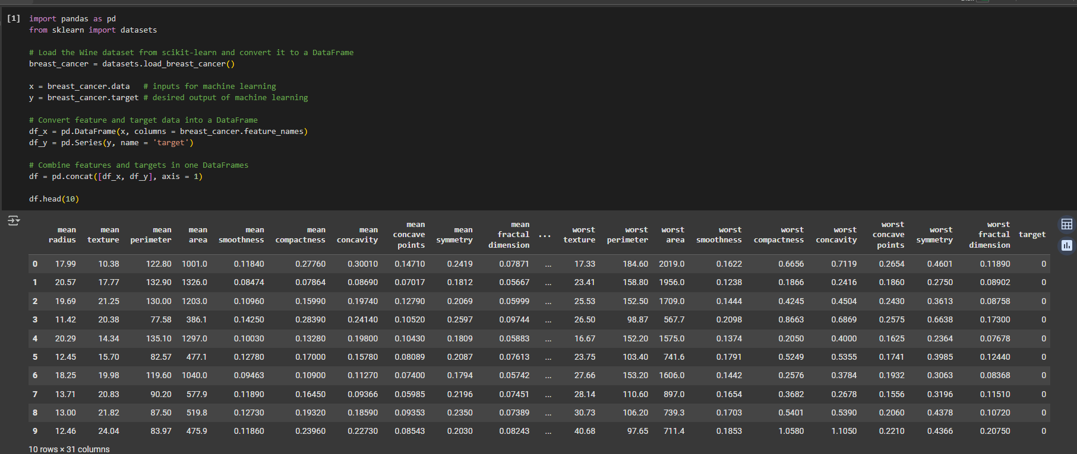
INPUT DATA

Slide 7

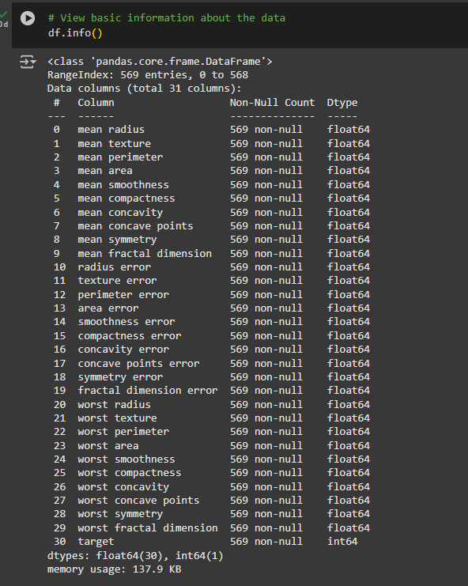
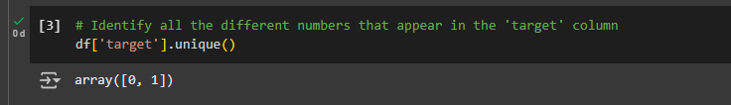

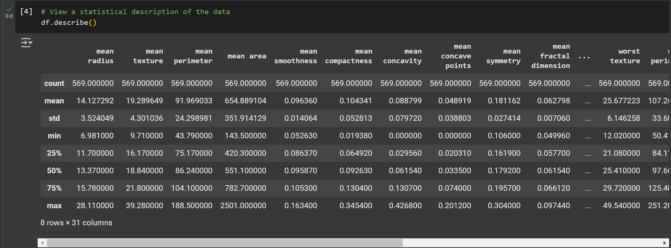
EXPLORATORY DATA ANALYSIS (EDA)

Slide 8

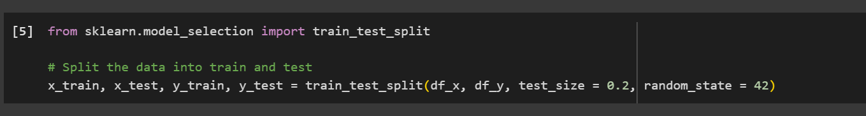
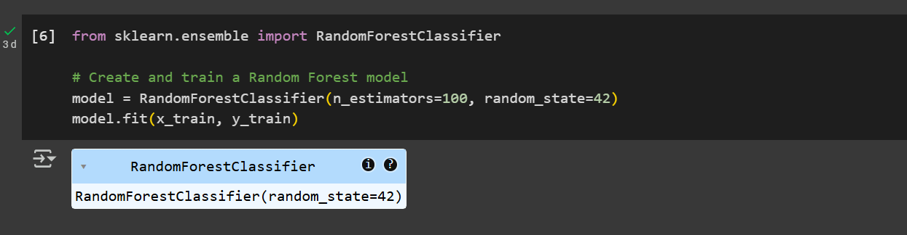
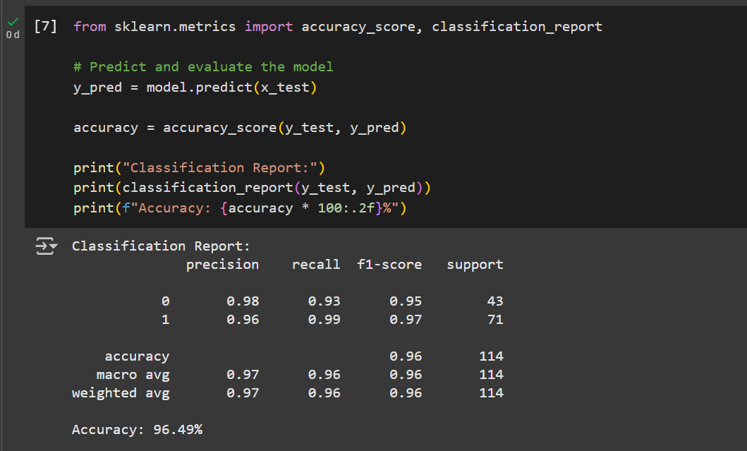
DATA MODELLING

Slide 9
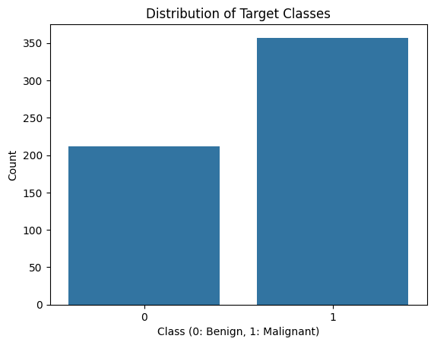
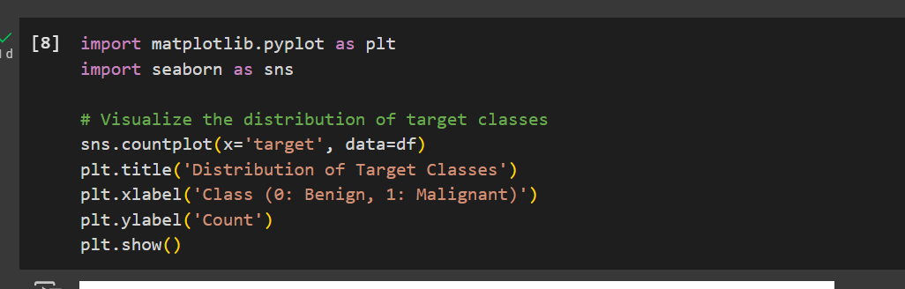


DATA VISUALIZATION
Distribution of Target Classes

Slide 10
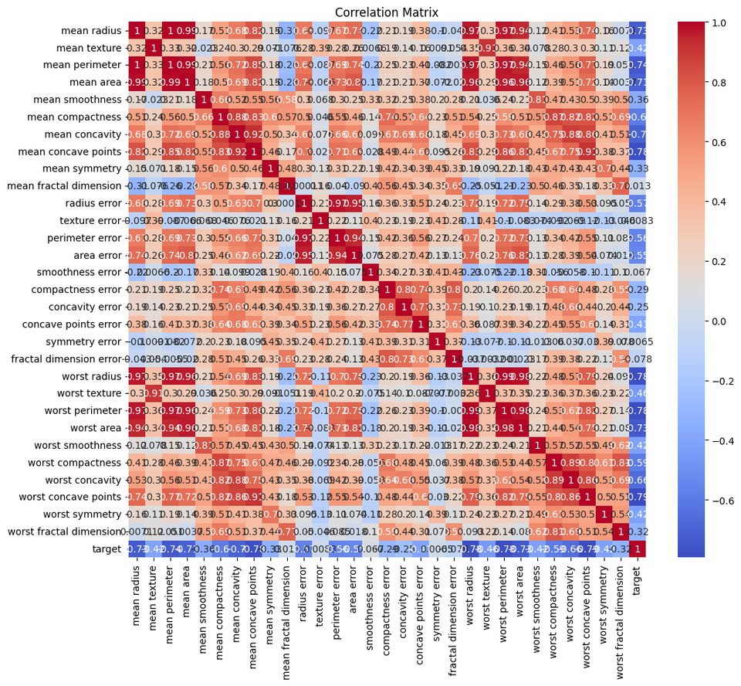
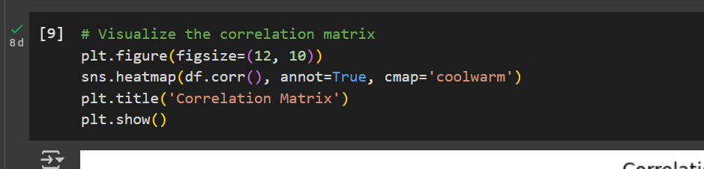


DATA VISUALIZATION
Correlation Matrix

Slide 11
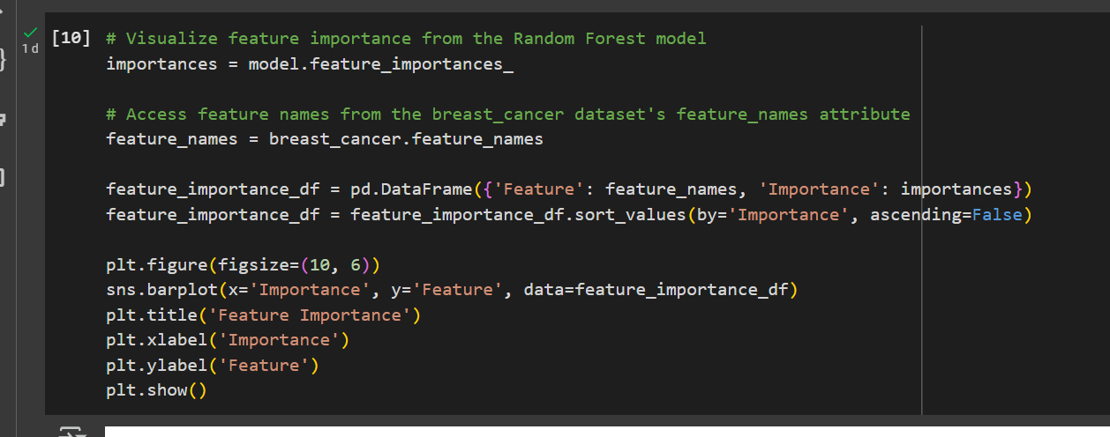
DATA VISUALIZATION
Feature Importance

Slide 12
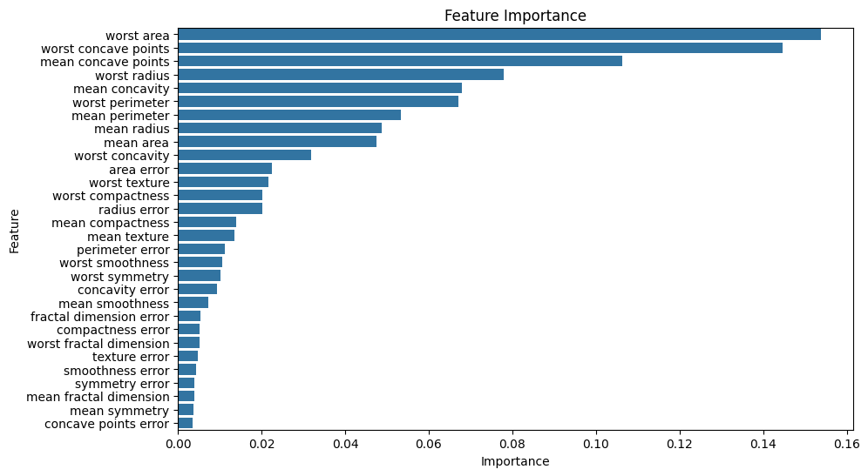
DATA VISUALIZATION
Feature Importance

Slide 13





THANK YOU
If you have any questions, suggestions or feedbacks, please do not hesitate to reach me through the contacts below:
rsgame99@gmail.com
github.com/DanicaAlana
linkedin.com/in/danica-alana-sjurjahady-85b124211/

